Slide 1
PDAT613G: Data Mining
Module 3A – Text Analytics

Slide 2
00 – Module 3: Text Analytics Overview
General Concepts
Examples
R Packages

Slide 3
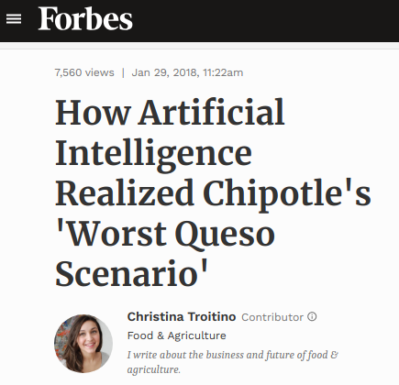
01 – Text Analytics Automates Information Extraction from Unstructured Text
Sentiment Analysis: Can we quantify a writer’s attitude?

Slide 4
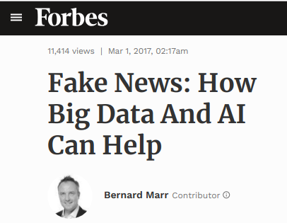
02 – Text Analytics Automates Information Extraction from Unstructured Text
Sentiment Analysis: Can we quantify a writer’s attitude?
Text Classification: Can we train the computer to identify certain sorts of text?

Slide 5
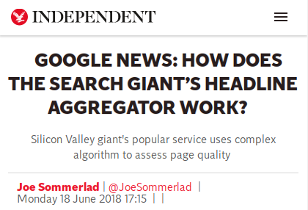
03 – Text Analytics Automates Information Extraction from Unstructured Text
Sentiment Analysis: Can we quantify a writer’s attitude?
Text Classification: Can we train the computer to identify certain sorts of text?
Text Clustering: Can we find new structure in a set of texts?

Slide 6
04 – Parsing Natural Language Is Not Always Easy
Same words/different meaning. (Homonymy) | “He was buried in the plot.” “He was immersed in the plot.”
Different words/similar meaning. (Synonymy) | “She was buried in work.” “She was immersed in work.”
Same word/linked meaning. (Polysemy) | “He was buried in the ground.” “He was buried in work.”
Negation | “Never, despite their claims, were they buried in work.”
Sarcasm | “If you’re playing solitaire, you must be buried in work.”

Slide 7
05 – Question
Which of the following may cause a problem in parsing the following sentence:
“It is not the case that the airline found my case.”
Check all that apply.
Homonymy
Synonymy
Polysemy
Negation

Slide 8

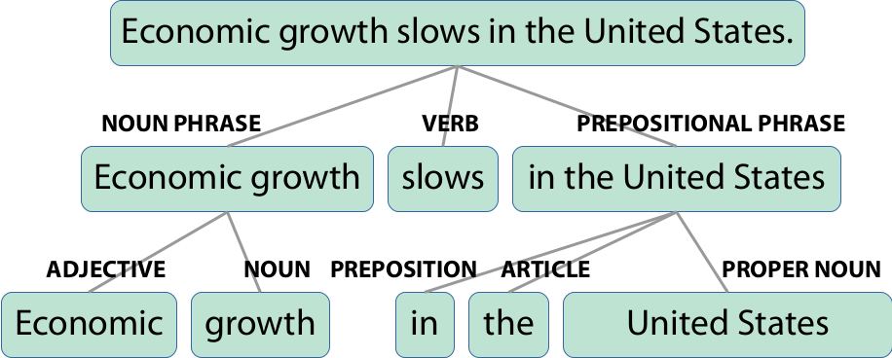
06 – Semantic Parsing vs. Bag-of-Words
Parsing is a non-trivial coding problem, while the bag-of-words approach leverages large data sets and machine learning.
They can be complementary.

Slide 9
07 – Because Language Is So Mutable, Preprocessing Text Is Often Necessary
“Zipf’s Law”: Empirically, the frequency of a word tends to be inversely related to its rank on a frequency table.
word Freq Rank 1 the 5346 1 2 to 5095 2 3 i 4379 3 4 and 3368 4 5 app 2666 5 6 a 2566 6

Slide 10
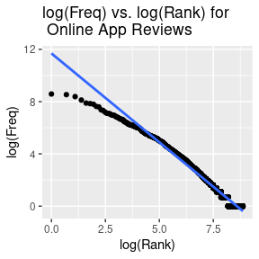
08 – Because Language Is So Mutable, Preprocessing Text Is Often Necessary
“Zipf’s Law”: Empirically, the frequency of a word tends to be inversely related to its rank on a frequency table.
A scatter plot showing the close-to-linear relationship between log of work rank and log of word frequency.

Slide 11
09 – Because Language Is So Mutable, Preprocessing Text Is Often Necessary
“Zipf’s Law”: Empirically, the frequency of a word tends to be inversely related to its rank on a frequency table.
Remove common words (so-called “stop-words”)?
[1] "i" "me" "my" "myself" "we" [6] "our" "ours" "ourselves" "you" "your" [11] "yours" "yourself" "yourselves" "he" "him" [16] "his" "himself" "she" "her" "hers" [21] "herself" "it" "its" "itself" "they" [26] "them" "their" "theirs" "themselves" "what" [31] "which" "who" "whom" "this" "that" [36] "these" "those" "am" "is" "are" [41] "was" "were" "be" "been" "being" [46] "have" "has" "had" "having" "do" [51] "does" "did" "doing" "would" "should" [56] "could" "ought" "i'm" "you're" "he's" [61] "she's" "it's" "we're"

Slide 12
10 – Because Language Is So Mutable, Preprocessing Text Is Often Necessary
“Zipf’s Law”: Empirically, the frequency of a word tends to be inversely related to its rank on a frequency table.
Remove common words (so-called “stop-words”)?
When are words the same? Remove capitalization, punctuation, word endings, numbers, etc?
[1] "i" "me" "my" "myself" "we" [6] "our" "ours" "ourselves" "you" "your" [11] "yours" "yourself" "yourselves" "he" "him" [16] "his" "himself" "she" "her" "hers" [21] "herself" "it" "its" "itself" "they" [26] "them" "their" "theirs" "themselves" "what" [31] "which" "who" "whom" "this" "that" [36] "these" "those" "am" "is" "are" [41] "was" "were" "be" "been" "being" [46] "have" "has" "had" "having" "do" [51] "does" "did" "doing" "would" "should" [56] "could" "ought" "i'm" "you're" "he's" [61] "she's" "it's" "we're"

Slide 13
11 – Question
Which of the following is a consequence of Zipf’s law?
It is possible to formulate a relatively small list of very common “stop words” that can often be removed from a text corpus during pre-processing.
Given a corpus of natural language utterances, most words appear with roughly equal probability.
Often, the words that lend the most specific meaning to a text corpus also appear with the greatest frequency, thus making their identification easier.
None of these

Slide 14
12 – Text Preprocessing Commands, Part 1
Command | Description | Input | Output
tolower (base R) | All words lower lower case. | Dinner in Paris! | dinner in paris!
removePunctuation (tm) strip (qdap) | Remove punctuation. | Dinner in Paris! | Dinner in Paris
removeNumbers (tm) strip (qdap) | Remove digits from text. | Dinner at 10 Downing St. | Dinner at Downing St.
trimws (base R) stripWhitespace (tm) Trim (qdap) | Remove extra spaces/tabs/etc. | Dinner with the Queen! | Dinner with the Queen!
stemDocument (tm) stemmer (qdap) | Collapse word forms to their base form. | My specialty and their specialities | My specialti and their specialti
stemCompletion (tm) | Expand stems to a common full word. | My specialti and their specialti | My specialties and their specialties

Slide 15
13 – Text Preprocessing Commands, Part 2
Command | Description | Input | Output
replace_number (qdap) | Replace digits by words. | Dinner at 10 Downing St. | Dinner at ten Downing St.
replace_abbreviation (qdap) | Replace abbreviations with their full forms. | Dinner is at 7:00 p.m. | Dinner is at 7:00 PM.
replace_contraction (qdap) | Write contractions out in full. | I won’t eat until the guests arive. | I will not eat until the guests arrive.
replace_symbol (qdap) | Replace symbols with their words. | Dinner @ nine! | Dinner at nine!
Custom functions (e.g. remove links or non-alphanumeric characters)

Slide 16
14 – Question
If your text analysis algorithm involved comparing your text to a pre-set dictionary like the one below, which of the following pre-processing procedures would be safe to apply to your text? (Check all that apply.)
Punctuation removal
Stemming
Number conversion
White space trimming
Stop word removal
unqualifying ungravitative prosodical self-created assumptive tartrated homological starch-reduced center-fire geophilous unfungible bistred sarmatian toylike sauceless sarmentose uncontending brassicaceous unexceptable octodecillionth

Slide 17
15 – Several R packages do text analytics and offer overlapping features.
tidytext: Emphasizes storing text in “tidy” formats and operating on it using dplyr and tidyverse principles.
tm: Stores texts in ``corpus’’ format with metadata. Text pre-processing and document-term matrices.
qdap: Emphasis on pre-processing and calculating various measures, such as sentiment, readability, etc.
sentimentr: Another package to calculate text sentiment in a more nuanced way.
quanteda: Relatively new; unifies features in one programming interface.

Slide 18
16 – R packages for text analytics expect data in different formats.
-- tidytext --
id word 1 1 the 1.1 1 food 1.2 1 was 1.3 1 excellent 2 2 the 2.1 2 service 2.2 2 wasn't 2.3 2 bad
-- qdap: Character vector of texts. --
id review 1 1 The food was excellent. 2 2 The service wasn't bad, and the foo 3 3 Overall excellent dinner, even on a
-- tm: A 'Corpus' structure. --
<<VCorpus>> Metadata: corpus specific: 0, document level (indexed): 0 Content: documents: 3

Slide 19
17 – Sentiment analysis measures the emotional content of text.
Supervised: Predictive models (random forests, neural nets, etc.) learn to assign sentiment to texts from many examples.
Unsupervised: A lexicon is used to assign sentiment values to words, and algorithms parse sentences to assign sentiment scores.
Sentiment can be simply Positive/Negative, or multidimensional (Fearful/Angry/Joyous/Funny/etc.)

Slide 20
18 – Averaging word scores is simple, but can be fooled by complex sentences.
word value 1 the NA 2 movie NA 3 was NA 4 exciting 3
Average: 0.75
word value 1 the NA 2 movie NA 3 wasn't NA 4 bad -3
Average: -0.75
word value 1 i NA 2 don't NA 3 believe NA 4 that NA 5 new NA 6 movie NA 7 was NA 8 very NA 9 exciting 3 10 or NA 11 funny 4
Average: 0.63636

Slide 21
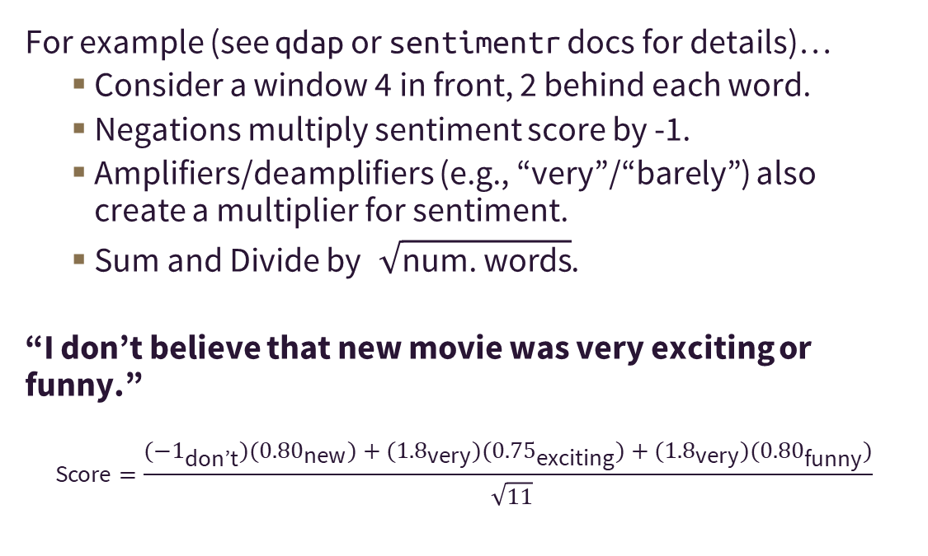
19 – More nuanced sentiment algorithms consider negations and amplifiers.
For example (see qdap or sentimentr docs for details)…
Consider a window 4 in front, 2 behind each word.
Negations multiply sentiment score by -1.
Amplifiers/deamplifiers (e.g., “very”/“barely”) also create a multiplier for sentiment.
Sum and Divide by $\sqrt{\text{num}\text{. }\text{words}}$.
“I don’t believe that new movie was very exciting or funny.”
$$\text{Score}=\frac{(−1_{\text{don}\text{’}\text{t}})({0.80}_{\text{new}})+({1.8}_{\text{very}})({0.75}_{\text{exciting}})+({1.8}_{\text{very}})({0.80}_{\text{funny}})}{\sqrt{11}}$$

Slide 22
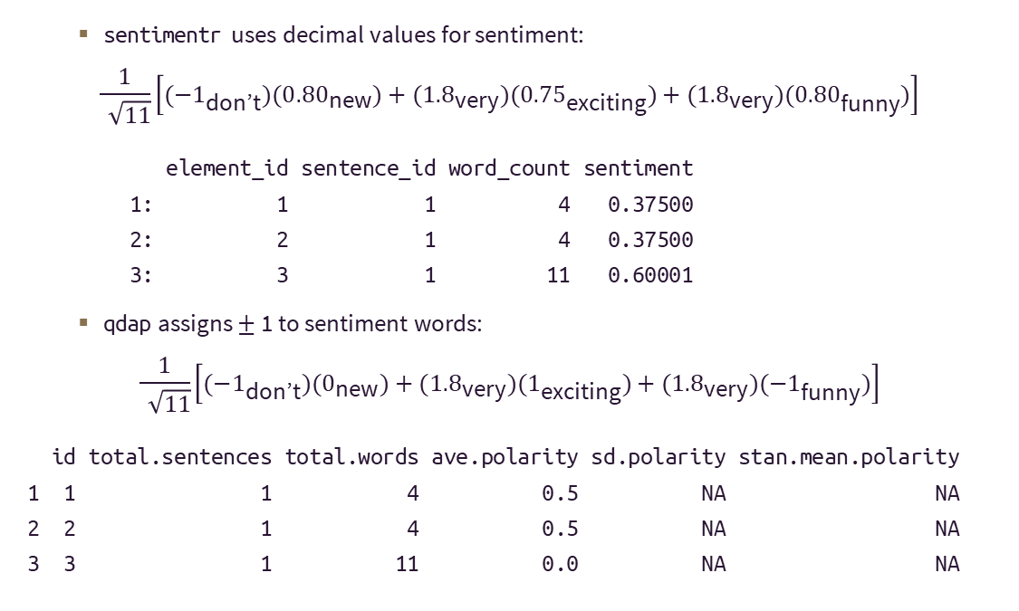
20 – The choice of lexicon can have a significant effect on final sentiment scores.
sentimentr uses decimal values for sentiment:
$$\frac{1}{\sqrt{11}}\left[(−1_{\text{don}\text{’}\text{t}})({0.80}_{\text{new}})+({1.8}_{\text{very}})({0.75}_{\text{exciting}})+({1.8}_{\text{very}})({0.80}_{\text{funny}})\right]$$
element_id sentence_id word_count sentiment 1: 1 1 4 0.37500 2: 2 1 4 0.37500 3: 3 1 11 0.60001
qdap assigns $±$ 1 to sentiment words:
$$\frac{1}{\sqrt{11}}\left[(−1_{\text{don}\text{’}\text{t}})(0_{\text{new}})+({1.8}_{\text{very}})(1_{\text{exciting}})+({1.8}_{\text{very}})(−1_{\text{funny}})\right]$$
id total.sentences total.words ave.polarity sd.polarity stan.mean.polarity 1 1 1 4 0.5 NA NA 2 2 1 4 0.5 NA NA 3 3 1 11 0.0 NA NA

Slide 23
21 – Question
What answer below gives a possible numeric sentiment value and polarity for the sentence below? (Note: Various R commands will give varying numeric values.)
“Truman plays a major role in this friendly community, and the town embraces and welcomes students and their families with warm smiles. Students discover a place where they can pursue their interests and create a rich college experience that they’ll remember long after graduation.”
-0.745, positive
0.745, positive
0.745, negative
-0.745 negative

Slide 24
22 – Example: Real vs. Fake News
The Onion publishes satire in the form of fake news stories.
Huffington Post publishes about “real” news.
Can we find a way to tell the difference?
Examples:
The Onion: “Never-before-heard buzzword flying around office can’t be good.”
Huffington Post: “Two big tobacco companies want to merge.”

Slide 25

23 – Text Analytics Example

Slide 26
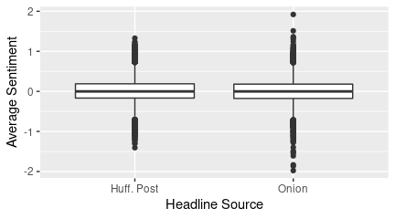
24 – Do the two sources differ in sentiment?

Slide 27
25 – Visualization Example

Slide 28
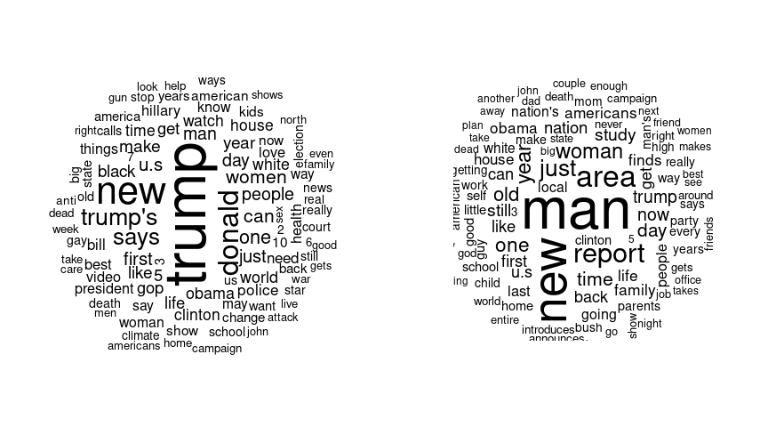
26 – Word clouds can help visualize word distribution.
How do the two sources differ?

Slide 29
27 – n-grams are chunks of n consecutive document words.
-- Huffington Post --
word1 word2 n 1 donald trump 350 2 hillary clinton 128 3 donald trump's 97 4 new york 87 5 year old 84 6 white house 82 7 supreme court 73 8 bernie sanders 64 9 climate change 59 10 health care 59
-- The Onion --
word1 word2 n 1 area man 225 2 year old 166 3 study finds 103 4 white house 95 5 introduces new 61 6 high school 43 7 area woman 42 8 new study 40 9 supreme court 38 10 unveils new 36

Slide 30
28 – Prediction and clustering can be done using features from a document-term matrix.
A tiny example:
id reviews 1 1 I liked the cake. 2 2 I loved the movie.
The document-term matrix has one row per document, and a column for every word. Cell values are the in-document word frequencies.
Terms Docs cake i liked the loved movie 1 1 1 1 1 0 0 2 0 1 0 1 1 1
Theoretically, one could use this matrix in any prediction or clustering method that accepts numeric feature vectors. In practice, the large number of columns and sparse matrix can be an issue.

Slide 31
29 – Predictive Modeling Example

Slide 32
30 – Even without tuning, an SVM still predicts headline source better than chance
Confusion Matrix and Statistics Reference Prediction 0 1 0 3792 687 1 993 2541 Accuracy : 0.7903 95% CI : (0.7813, 0.7992)

Slide 33
31 – Clustering Example

Slide 34
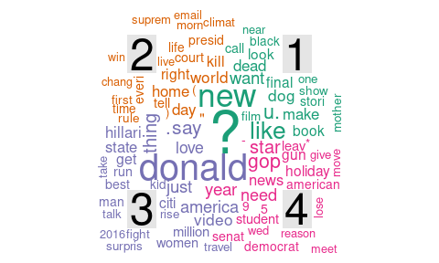
32 – Topic modeling can identify clumps of related headlines.

